Slide 1

GOLDEN EXPEDITIONS & DROPSIPPHING

Slide 2

The background of our project
Golden Expedition and Dropshipping is a company engaged in expedition and dropshipping that covers all district in jakarta, looking at problems that occur in several countries for office workers, who do not have time to collect goods. We as an expedition and dropshipping service provide storages closest to make it easier and can be reached from where the recipient (worker) lives.

Slide 3
Endpoint our project
time
accuracy
storage

Slide 4
TIME
Helping workers who are struggling to provide at any time on weekends or working days for the shipment they are waiting for

Slide 5
ACCURACY
help the accuracy of the goods the user receives, with a qr scan provided when the user will take the goods in our storage, or when the goods have arrived at the user's address

Slide 6
STORAGE
storage areas that are arranged with what we provide in each district, the area that we cover around the districts in Jakarta and we will develop it again later for the whole of Indonesia and internationally

Slide 7
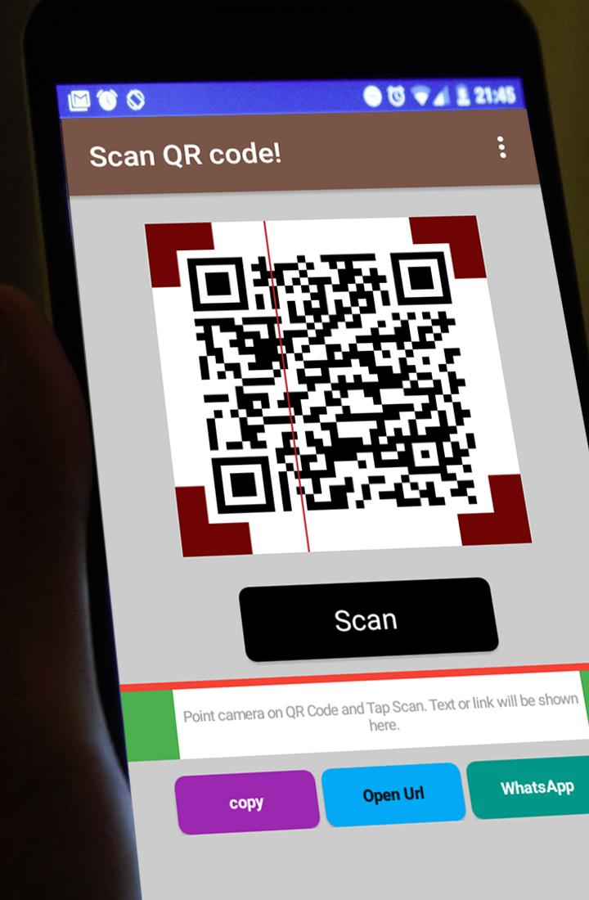
Features in our project
we integrate with data
scanning
to help workers who are
busy dividing their time

Slide 8

Realtime chat from the storage and customer
Features in our project

Slide 9
Bussiness procces

Slide 10
Why the reason use from our app
we have several storages to store goods when the courier does not meet the owner of the goods at the recipient's address
we integrate with data scanning which will be able to protect user private data

Slide 11

workflow of our project
Post Operator will Input data
if the courier updates in storage
Storage operator will scan data if there is a recipient of the goods coming
The courier runs the shipment
Transaction updates by courier
Update in our storage or user address

Slide 12

Thank you

